Slide 1

`
URL DETECTOR
BY HIMANSHU DHINGRA (2110993793) HARSHIT BEHL (2110993788)
CSE-AI (G1)

Slide 2
URL HUNTER
URL Hunter is a URL detector for web users.
Fake or Malicious URLs are something which we come across in our day to day lives.
Whether it is surfing the internet or reading mails/messages, every day we click on a fair chunk of URLs irrespective of its safety or legibility.
Hence it is a problem to our work efficiency.

Slide 3
Introductory Overview
A python-based program using machine learning to detect fake or malicious mails.
A good feature for professionals working in cyber sector.

Slide 4
FEATURES
Libraries like NumPy, Pandas and Flask are used to do feature engineering and setup to ensures easy working.
SKlearn used to for training ML models.
It helps in detection of various types of URLs into ‘Safe’, ‘Malware’ and ‘Phishing’.
Model built using lexical features for detecting malicious URLs.
Minimal and fast way of working.

Slide 5
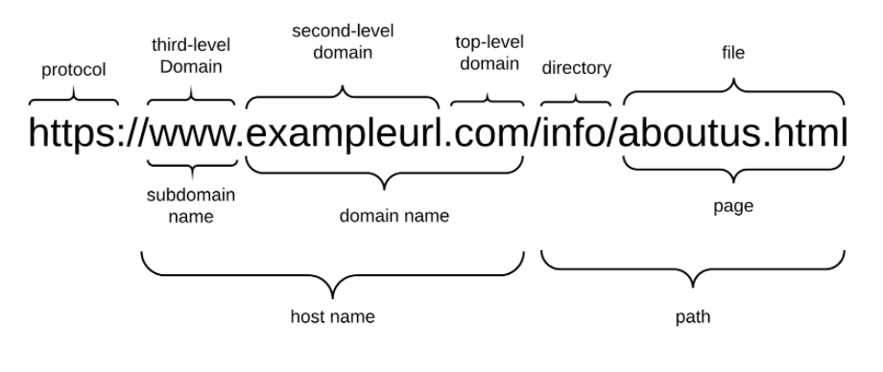
METHODOLOGY

Slide 6
.
METHODOLOGY
Data Collection
Data Pre-processing
ML Model
Evaluation
.

Slide 7
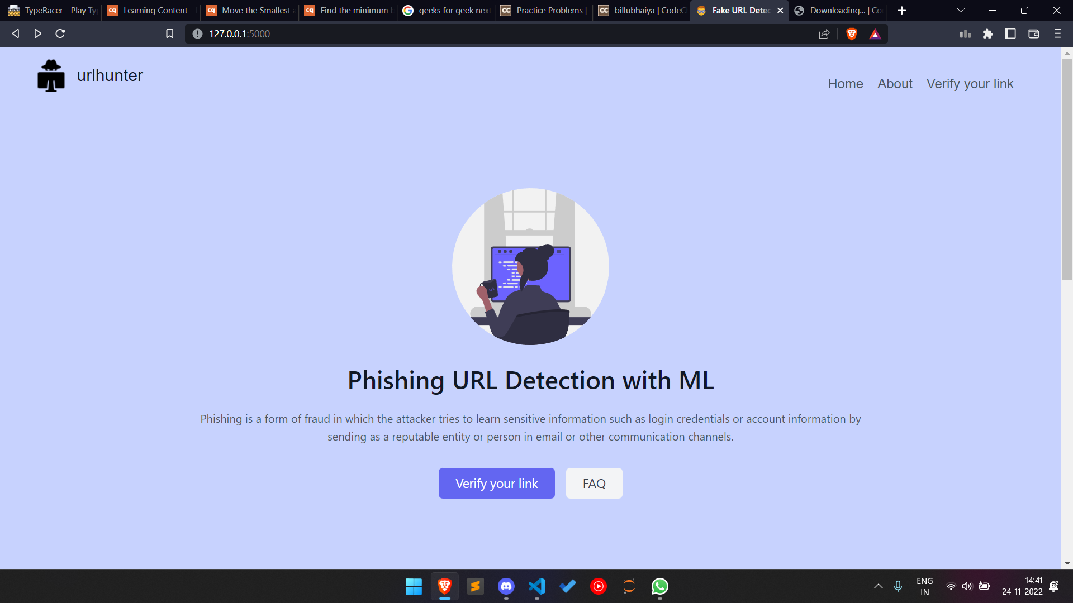

Slide 8
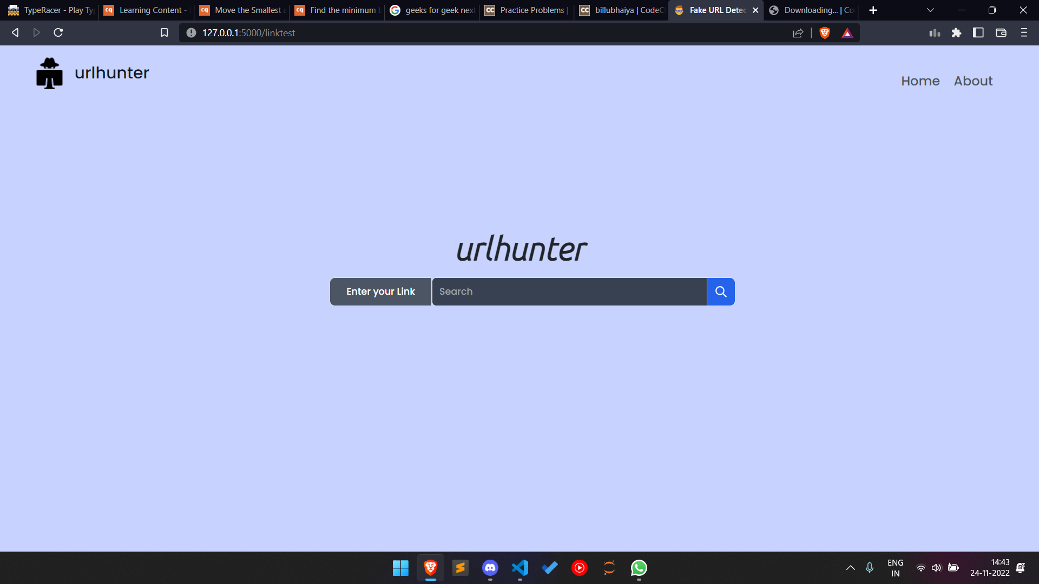

Slide 9
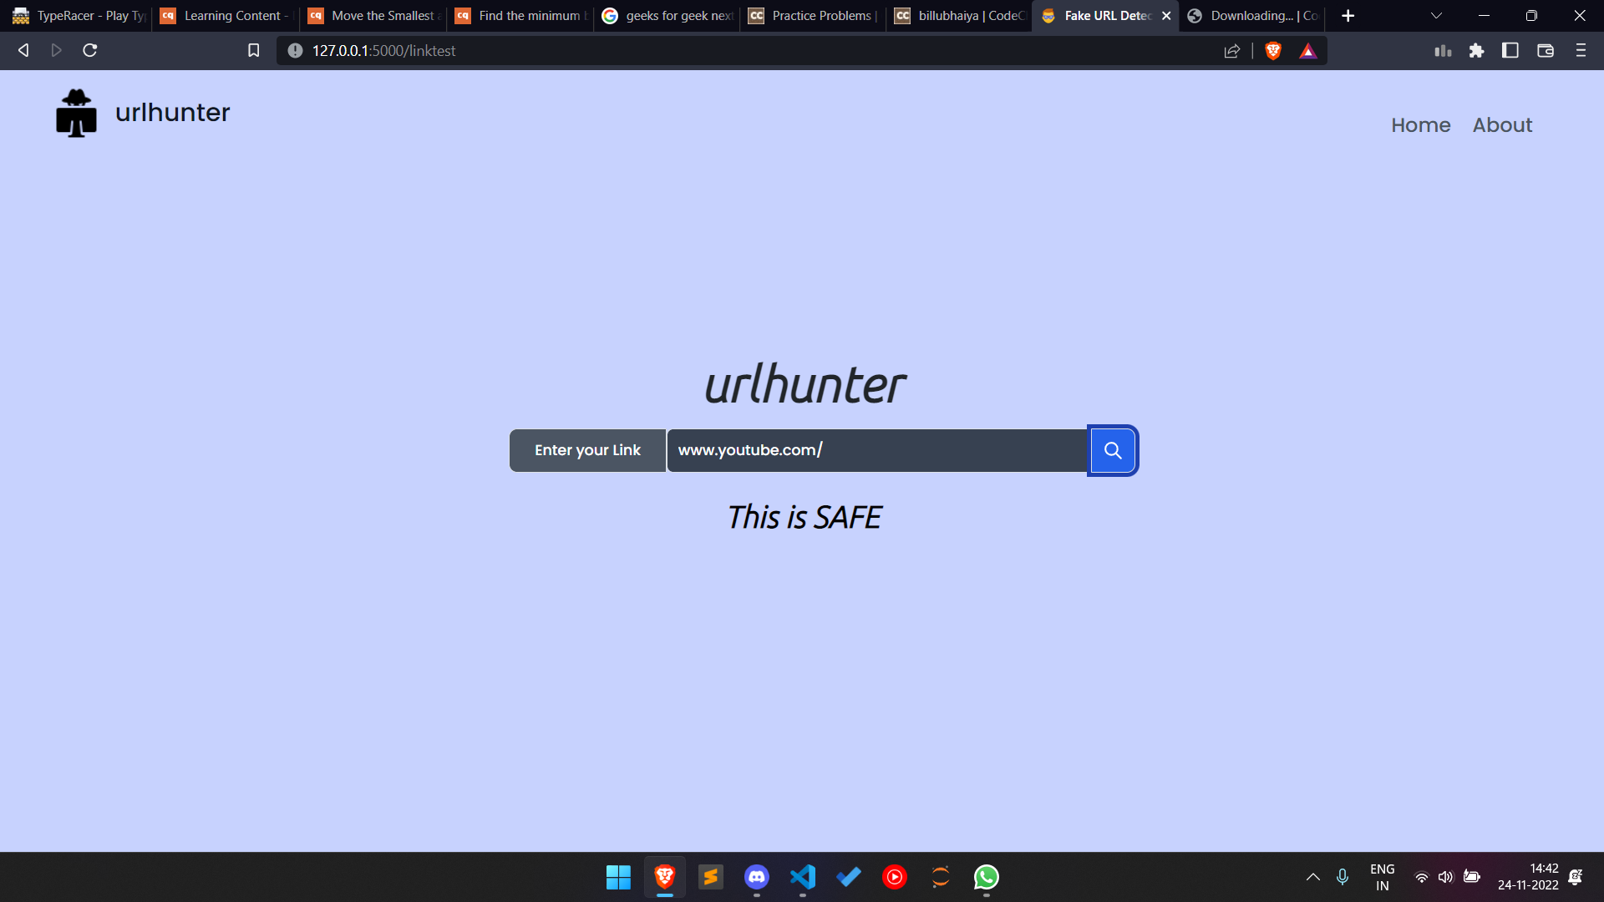

Slide 10
TRIVIA
Plays a pivotal role in ensuring ease in internet surfing.

Slide 11
Resources
Tail Blocks
Icon8
Python.org

Slide 12
THANK YOU!
“Technology trust is a good thing, but control is a better one.”
__________

Slide 13


